Slide 1

Embracing our values
January 2024

Slide 2


Workshop agenda
Presentation of FORVIA’s values 10’
Intro – Why this workshop 2’
FORVIA’s values and us 30’
Conclusion 5’

Slide 3






01
Introduction

Slide 4


Workshop objectives
Highlight how we can embody these values, in our missions and within our team
Share & Explain FORVIA’s values

Slide 5
02
FORVIA’s values

Slide 6
The new FORVIA values
They are a new step in the construction of FORVIA’s identity.
They are the foundations of our common culture.
They were built in co-design between Faurecia & HELLA, they reflect their historical values.
They are also tailor-made for the current and future challenges we face
Notes:
We started building FORVIA’s identity by finding its name, then a logo and a whole visual identity, and a sound signature.
Our vision and mission were defined thanks to workshops including more than 60 participants from both Faurecia and HELLA.
Mission: We pioneer technology for mobility experiences that matter to people
Since then, we introduced FORVIA to the world through major events and through common roadmaps.
After all that, the values are a new milestone in the construction of FORVIA’s identity.
Our values unite us, they are guiding principles.
They have a direct impact on how we collaborate within our teams and interact with our stakeholders.
They make us proud to belong to the group.
They make us feel engaged and want to move forward together.
Externally, they represent who we are as FORVIANS. They differentiate FORVIA from the competition and make it more attractive for candidates.
The new FORVIA values are in direct line with the historical values from both Faurecia and HELLA, built a few years ago.
Since then, our context evolved a lot: major business changes, major change in people’s expectations accelerated by Covid crisis in a context of talent scarcity, creation of the FORVIA group…
Given all these changes, we had to question our existing cultural models and values and to update them to reflect who we are now and adapt the way we work to our new context.
We decided of the FORVIA values in co-design, with 4 workshops involving +40 people, with very diverse profiles from both Faurecia and HELLA.
The strong common grounds, easy convergence and agreement on key topics observed during the workshops were the perfect start to define our new values together.
Based on all this work and context, the Management Board and the ExCom had a seminar to define together the values that bring us together and express FORVIA’s specific identity.

Slide 7
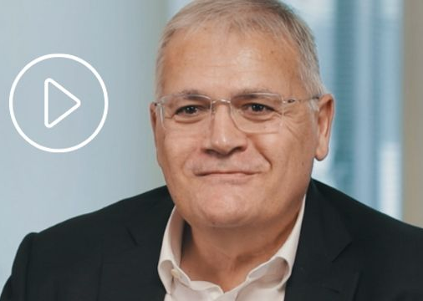
The new FORVIA values
Drive
Accountability
Teamwork
Agility
Respect
Open-mindedness

Slide 8
The new FORVIA values
We drive with vision
We embrace agility
We build on accountability
We act with respect
We cultivate teamwork
We believe in open-mindedness
ONE MISSION:
WE PIONEER TECHNOLOGY FOR MOBILITY EXPERIENCES THAT MATTER TO PEOPLE

Slide 9

DRIVE
We drive with vision
By inspiring and leading our teams toward a high level of engagement to achieve a safe, affordable and sustainable mobility for all.
By demonstrating ambition for the business, entrepreneurship, courage and energy.

Slide 10

ACCOUNTABILITY
We build on accountability
By taking full ownership of our scope of responsibility, empowered by delegation and appropriate resources, with full transparency of successes and mistakes.
By committing to delivering results, creating value and having a positive impact on society.

Slide 11

TEAMWORK
We cultivate teamwork
By leveraging strengths and diversity of profiles, engaging them in constructive dialogue, while involving our entire ecosystem to build a sustainable future.
By attracting and developing the best talents and ensuring robust succession.

Slide 12
AGILITY
We embrace agility
By demonstrating situational awareness, willingness and ability to constantly learn to perform successfully in a fast-changing environment.
By taking initiative to successfully navigate unknown and unforeseen challenges.

Slide 13

RESPECT
We act with respect
By building long-term relationships with stakeholders and treating them fairly with respect.
By developing a trustful and caring environment where all talents can grow to their ultimate potential.

Slide 14

OPEN-MINDEDNESS
We believe in
open-mindedness
By constantly looking for innovation, listening to open new business perspectives.
By welcoming diversity of ideas and experiences, and building an inclusive culture.

Slide 15
03
FORVIA’s values and us

Slide 16
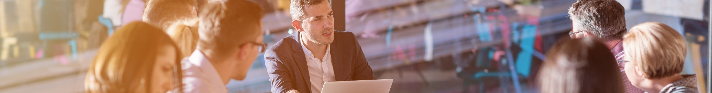
How do the values apply to us?
Group discussion
30’
Choose 1 or 2 recent group milestones (contract, project, innovation, event…) and analyze how it reflects our values.
Find and share examples illustrating how you can embody FORVIA’s values daily, at your level.
It’s up to us to transform FORVIA’s values into actions!

Slide 17
04
Wrap up &
conclusion

