Slide 1
Hella 8D Report_ Supplier Training Material 海拉8D报告_供应商培训资料
Lippstadt 2017-11-20
HCC-PU-QM

Slide 2
Motivation to make the 8D report
编写8D报告的动机
How to fill out Hella 8D report
如何填写海拉8D报告
8D Report Evaluation
8D报告的评估
8D Training suppliers | Keppmann | HCC-PU-QME - Lippstadt, Nov 2017

Slide 3
8D – Introduction 8D介绍
8 Disciplines Problem Solving (8D) is a method used to approach and to resolve problems, typically employed by quality engineers or other professionals;
8D问题解决工具是一种处理和解决问题的方法，通常地被质量工程师或其他专业
人员采纳使用；
Its purpose is to identify, correct and eliminate recurring problems, and it is useful in product and process improvement.;
它的目的是识别问题，纠正问题及消除问题再发，并在产品和过程的改进上也是
很有帮助。
It establishes a permanent corrective action based on statistical analysis of the problem and focuses on the origin of the problem by determining its Root Cause. Although it originally comprised eight stages, or 'disciplines', it was later augmented by an initial planning stage;
它通过对问题进行统计分析来发现问题的根本原因，并且针对问题发生的根本原因建立有
针对性的永久性纠正措施。最初它由8个步骤组成，后来在初步规划阶段优化了。
The 8D follows the logic of the PDCA Cycle.
8D遵循PDCA循环法则。
3
8D Training suppliers | Keppmann | HCC-PU-QME - Lippstadt, Nov 2017
Notes:
29.05.2018

Slide 4
Advantages 优点
Easy and logically method, clearly shows next steps of problem solution.
容易且具逻辑的方法，清晰的展现问题解决的下一步动作。
The method is known and used by all companies from the automotive industry.
这个方法众所周知并普遍运用于汽车行业。
Often this is a required method of documenting the Corrective/Preventive action for the problem.
通常被要求对问题的纠正预防措施进行文件化管理的方法。
An excellent way of reporting nonconformance’s to suppliers and their Corrective/Preventive actions.
它是一种供应商用于报告不合格和纠正/预防措施的好方法。
4
Notes:
29.05.2018

Slide 5
8D Problem Solving 8D 问题解决
8D follows the logic of the
PDCA Cycle
8D 遵循PDCA循环法则
ACTION纠正
8 Final meeting
末次会议
1 Problem Solving Team
问题解决
团队
PLAN策划
7 Prevention
of recurrence
of the non-conformity
不良再发生预防
2
Problem Description
问题描述
8D
Process
3
Containment Action
临时围堵措施
Corrective actions 6 effectiveness validation纠正
措施效果验
证
CHECK确认
Corrective actions and
5 tracking of effectiveness
纠正措施及效
果跟踪
4
Root Cause Analysis
根本原因分析
DO执行
5
Notes:
29.05.2018

Slide 6
Motivation to make the 8D report
编写8D报告的动机
How to fill out Hella 8D report
如何填写海拉8D报告
8D Report Evaluation
8D报告的评估
8D Training suppliers | Keppmann | HCC-PU-QME - Lippstadt, Nov 2017

Slide 7
8D Steps 8D 步骤
D1
Problem solving team 问题解决团队
D2
Problem description问题描述
D3
Containment actions临时遏制
D4
Root cause analysis根本原因分析
D5
Corrective actions and tracking of effectiveness纠正措施及效果追踪
D6
Corrective actions effectiveness validation纠正措施的验证
D7
Prevention of recurrence of the non-conformity不良再发生的预防
D8
Final meeting末次会议
7

Slide 8
D1 — Problem Solving Team D1 — 问题解决团队
D1
D 1
D 3
D 4
D 5
D 6
D 7
D 8
Task
任务
Select team members选择团队成员
Members with appropriate skills are nominated based on the problem description
根据问题描述选择具备相关技能的团队成员。
A team leader is appointed
指定团队负责人 Confirmation of the team structure and assignment of responsibilities among the team members
团队组织架构确认及团队成员职责委任。
Action
行动
Target
目标
8

Slide 9
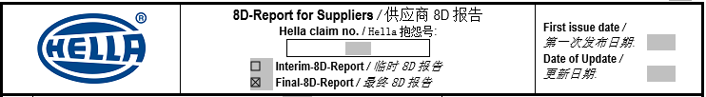
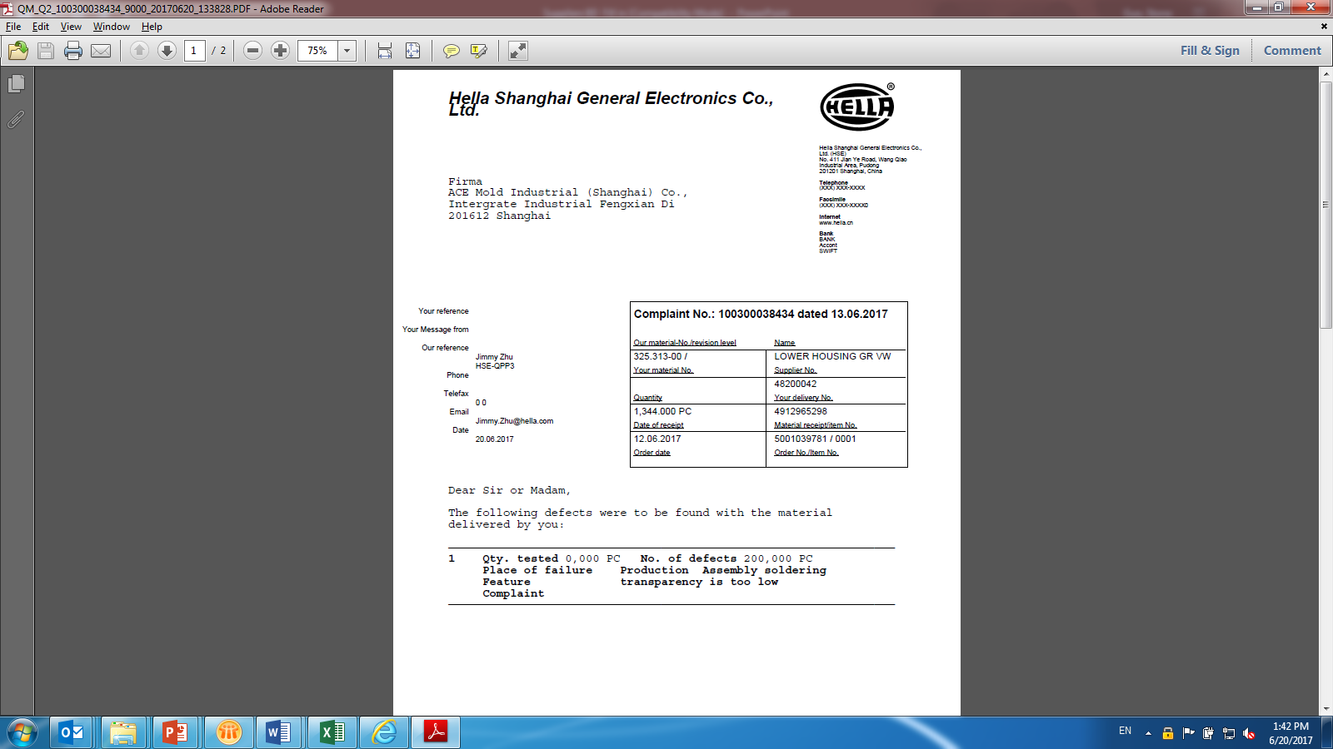
D1 — Problem Solving Team Header of 8D report filled with information come from Hella’s Quality Notification letter. 8D表头信息来自于Hella 质量通知信
1
4
2
3
5
Please fill in right information according to below explanation:
请根据Hella投诉信内容填入正确的信息：
1
Hella claim no. can directly get from Hella QN.
可以从Hela质量抱怨信获得Hella抱怨号
2
Interim 8D Report: D8 not finished.
临时8D报告日期： 8D没有最终完成
3
Final 8D Report: D8 finished.
最终8D报告日期：D8完成
4
First issue date: Official issue date to Hella, e.g. it’s always a date when supplier finished D3 or D5, which is required by Hella SQA.
第一次发布日期：官方回复给Hella的日期，如：通常按Hella要求供应商回复D3或D5的日期
5
When 8D is updated, supplier shall update with this date.
当8D报告更新后，供应商需要更新报告更新日期。
9

Slide 10
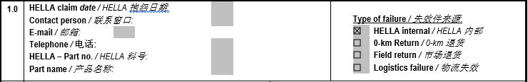
D1 — Problem Solving Team Information regarding Hella contact person and claim subject 关于Hella联系窗口及抱怨方面的信息
1
2
3
4
5
6
All above items can directly get from Hella QN. As following attachment show:
上面所有的条目都可以直接从Hella的质量抱怨信上获得，如下附件显示：
-
1
2
5
6
021-6160xxxx
4
3
10

Slide 11
D1 — Problem Solving Team Type of failure 失效类型
1
2
3
4
1
If the failure part is detected from Hella plant. Please select ‘Hella internal’.
如果失效件来自Hella内部工厂，请勾选‘Hella internal’
If the failure part is detected from Hella’s customers, for example OEM, Tier 1. Please select ‘0-km Return’.
如果失效件来自Hella的客户，如OEM，一级供货商。请选择‘0 公里退回’
If the failure part is detected from consumer side (e.g. 4S store or markets), Please select ‘Field return’.
如果失效件来自消费者（如，4S店或用户市场）, 请选择‘市场退货’。
If the failure part is detected as logistic failure. Please select ‘Logistics failure’.
如果失效件来自物流，请选择‘物流失效’。
2
3
4
11

Slide 12
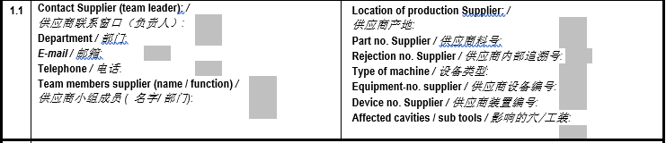
D1 — Problem Solving Team Supplier information: contact person, location, material, tools 供应商信息：联系人，产地，材料，工装等
1
6
2
7
3
8
4
9
5
⑩
⑪
⑫
1
The name of supplier contact person;
供应商联系窗口姓名
7
Supplier internal part No.
供应商内部料号
2
Which department did supplier contact person work?
供应商联系窗口所在部门
8
Supplier internal claim tracking number;
供应商内部抱怨追溯编号
3
Supplier contact person’s E-mail;
供应商联系窗口邮箱
9
Type of machine, e.g. injection molding/stamping/die-casting, etc.
机器类型，如：注塑/冲压/压铸等。
4
Supplier contact person’s telephone;
供应商联系窗口电话
⑩
Equipment number which defect part manufactured;
失效件使用的设备编号
5
Supplier cross functional team member, including name and Dept.供应商多功能能小组成员姓名及部门
⑪
Devices number, e.g. tool number, fixture number which dedicated for this part;
工装编号，如：模具号，辅具号；
6
Supplier manufacturing site/plant/workshop for this defect part;供应商失效件的制造地点/工厂/车间
⑫
The name of supplier which cavity or fixture be affected by this complaint .
哪个模具或工装的穴号
12

Slide 13
D2 — Problem Description D2 — 问题描述
D 1
D2
D 3
D 4
D 5
D 6
D 7
D 8
Task
任务
Collect Information, data, facts and figures
收集信息，数据，证据和图片
Describe the problem (defect/deviation) as accurately as possible giving quantitative details 描述问题（不良/偏差）尽可能准确量化描述问题（不良/偏差）
Answer the questions below回答以下问题：
Who?谁？
What?什么？
When?何时？
Where?哪里？
Why?为什么？
How?如何？
How often?多久一次？
All problem solving team members must have a clear and fact based understanding of the problem 所有问题解决小组成员务必清楚并以事实为依据开展活动。
Problem
Past Present
Action
行动
(Target situation) (Present actual situation)
The cause of the deviation is unknown at first
Describe deviation (problem) on the basis of facts
Target
目标
Precise problem description
准确的问题描述
13

Slide 14

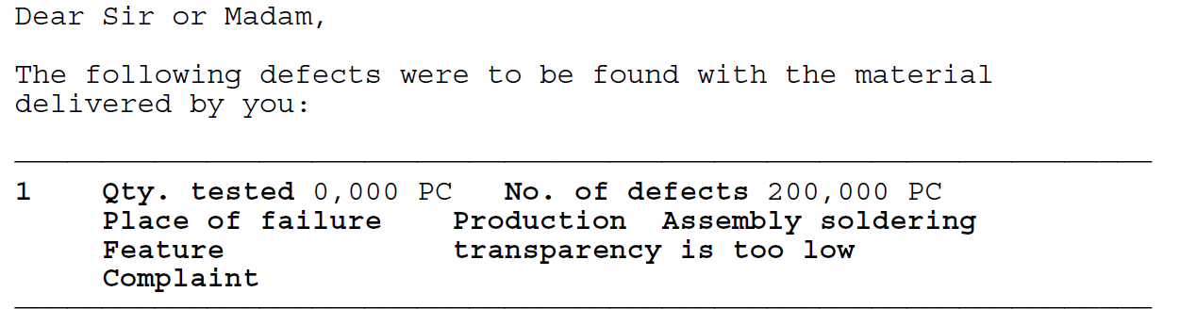
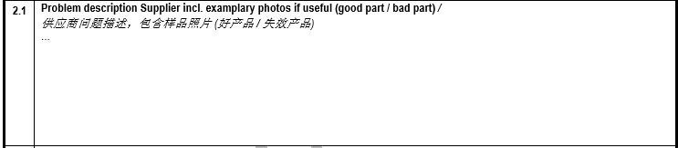
D2 — Problem Description D2 — 问题描述
1
Same as the description on Hella’s Quality Notification letter. 与Hella的投诉内容一致。
1
1
4W1H
what: defects description什么：不良描述
When: claim date何时：投诉日期
Where: warehouse, production line
哪里：仓库，生产线等
Who: Hella Incoming, production, or others
谁发现：Hella来料，生产或其他部门
how many: defects quantity found多少：已发现不良数量
2
Use Supplier internal language to describe what defects happen. Which characteristic can’t meet Hella drawing/requirement. OK/NOK parts shown.
使用供应商自己的语言来描述发生了什么不良。哪个特征没有满足Hella的图纸/要求。合格/不合格样品照片。
2
14

Slide 15

D2 — Problem Description D2 — 问题描述
1
2
3
1
If this failure happened before, select ‘Yes’;如果这个失效以前发生过，请选择‘是’
2
If this failure 1st time happened, select ‘No’;如果这个失效第一次发生，请选择‘不是’
3
If this is repeat issue, please fill in last Hella claim No. and last Supplier internal claim No.如果这是一个重复问题，请填写Hella的抱怨号及上次抱怨的供应商内部号
4
5
6
4
Can get directly from Hella’s Quality Notification Letter:
可以从Hella的质量通知信上直接获得。
5
Potential affected Quantity include :
Hella warehouse Q’ty+ On the Way Q’ty+ Supplier warehouse Q’ty.
潜在受影响的数量，包含：Hella仓库，在途，供应商仓库等
6
All parts under the same production condition.同等生产条件下的所有产品
Affected period
受影响的时段
Affected production record
受影响的生产批次
Affected quantity
受影响的数量
15

Slide 16
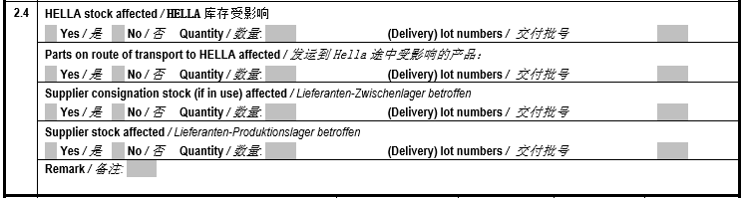
D2 — Problem Description D2 — 问题描述
1
2
3
4
Hella stock affected
On the way to HELLA affected
Potential affected
Hella stock supplier responsible
Supplier stock affected
1
If Hella stock affected, please select ‘yes’, otherwise ‘no’. And fill in affected quantity and corresponding ‘lot number’.
如果Hella库存受到影响，请选择‘是’，否则‘不是’。并填入影响的数量及对应的批次号。
2
If parts on route of transportation to Hella affected, please select ‘yes’, otherwise ‘no’. And fill in affected quantity and corresponding ‘lot number’.
如果是发运到Hella的在途品，请选择‘是’，否则‘不是’。并填入影响的数量及对应的批次号。
3
If Supplier consignation affected, please select ‘yes’, otherwise ‘no’. And fill in affected quantity and corresponding ‘lot number’.
如果供应商委托加工受到影响，请选择‘是’，否则‘不是’。并填入影响的数量及对应的批次号。
4
If Supplier stock affected, please select ‘yes’, otherwise ‘no’. And fill in affected quantity and corresponding ‘lot number’.
如果供应商库存受到影响，请选择‘是’，否则‘不是’。并填入影响的数量及对应的批次号。
16

Slide 17
D3 — Containment Actions D3 — 遏制措施
D 1
D 2
D3
D 4
D 5
D 6
D 7
D 8
Determine the most suitable containment actions
确定最合适的遏制行动
Containment actions must be taken to safeguard the situation, in order to prevent a recurrence of the problem at the customer.
遏制行动务必执行，预防问题在客户处再次出现。
Containment actions therefore serve only as a safeguard and often bear no relation to the cause of the problem.
遏制措施只是一种保障，往往与问题产生的原因没有关系。
Cost considerations should play little or no part in the initial response.
在最初的反应中，基本不考虑成本。
A schedule for implementing the containment actions must be developed and the effectiveness of the measures must be assessed.
必须给出执行遏制行动的时间进度，并且评估遏制措施的有效性
Instant information and support to the customer and implementation of containment actions as quickly as possible.
Task
Action
Target
及时向客户提供信息和支持，并尽快实施遏制措施
1. 24 hours: quick response e.g. containment actions at HELLA 1. 24小时响应遏制计划
2. 48 hours: containment actions fully implemented (D3 completed and sent to HELLA)
2. 48小时内完成遏制行动
17

Slide 18
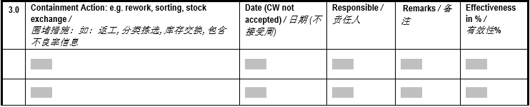
D3 — Containment Actions D3 — 遏制措施
1
2
3
4
5
1
In order to ensure Hella restart production, supplier need carry out effective urgent action, e.g. sorting, rework, stock exchange.
为了确保Hella重新生产，供应商需要执行有效的紧急措施，如：分拣，返工，换货等
2
Supplier action date instead of week.
供应商的行动细化到日而不是周。
3
Person who is responsible for containment action.
遏制行动的负责人。
4
Additional comments.
备注
5
Supplier shall fill in real effectiveness from Hella feedback.
供应商务必基于Hella的反馈来填写真实的有效性。
Containment action shall include ‘how to process affected stock’ and ‘how to ensure good parts to Hella’.
遏制行动必须包含如何处理受影响的库存及如何确保良品进入Hella。
18

Slide 19
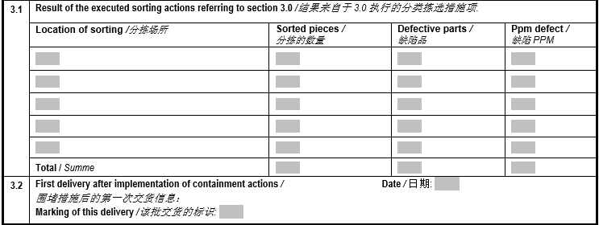
D3 — Containment Actions D3 — 遏制措施
1
2
3
4
Must update sorting result after sorting action
5
7
6
1
Location of supplier sorting
分拣地点
2
Total sorting quantity
总分拣数量
3
Total defects quantity
总不良数量
4
Total defects PPM
不良PPM
5
Don’t forget to summarize this
汇总
6
Mark/label of this delivery for better tracking
执行遏制行动后的标示以便更好的跟踪
7
First delivery after implementation of containment actions, PS: from supplier side
执行遏制行动后的第一次交货日期
19

Slide 20
D4 — Root Cause Analysis D4 — 根本原因分析
D 1
D 2
D 3
D4
D 5
D 6
D 7
D 8
Task
任务
Determination of the root cause确定根本原因
All possible causes of the defect must be considered.
所有可能的原因都需要被考虑
All possible causes should be determined and compared with the problem profile through systematic application of valid procedures, based on the physical, chemical and technical relationships and application of appropriate quality tools.
所有可能的原因都应该被考虑到，应系统地运用有效程序与问题
概括作比较，并运用物理，化学和相关技术及合适的质量工具来
分析。
The "Why" questioning technique should be applied determining the root cause.
‘为什么’质疑技巧应该应用于根本原因的确定
Confirmation of the root cause根本原因的确定
Action
行动
Target
目标
20

Slide 21
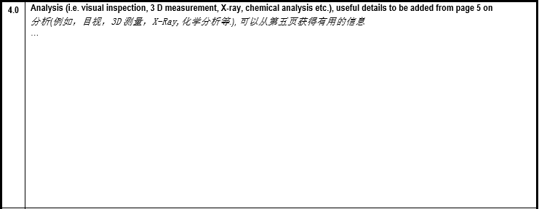
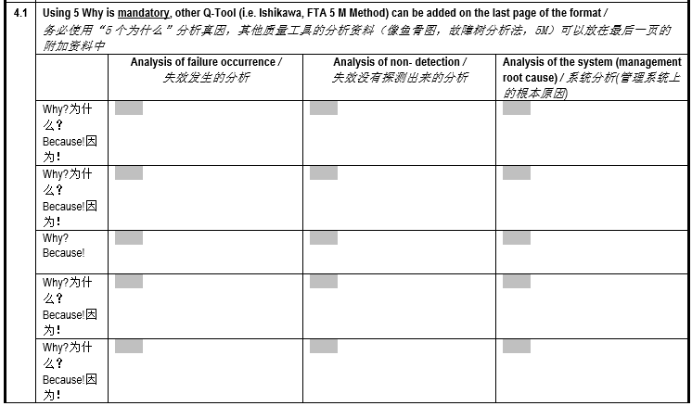
D4 — Root Cause Analysis D4 — 根本原因分析
Detail measurement methodology and procedure should be specified here.
详细的测量方法和流程应该说明清楚。
Use appropriate measurement to measure potential characteristics for OK parts and failure parts, also show all test result for analysis.
用合适的测量方法对OK品和失效品的潜在特性进行测量，并将测量结果用于分析。
PS:
It’s better that supplier provide specification or drawing for potential characteristics. 对于潜在特性，供应商最好能提供规格和图纸。
1.10working days: Root Cause Analysis
10个工作日完成根本原因分析和永久措施
analysis for occurrence, non-detection, system are mandatory
发生度/未探测/系统的分析是必须的。
21

Slide 22



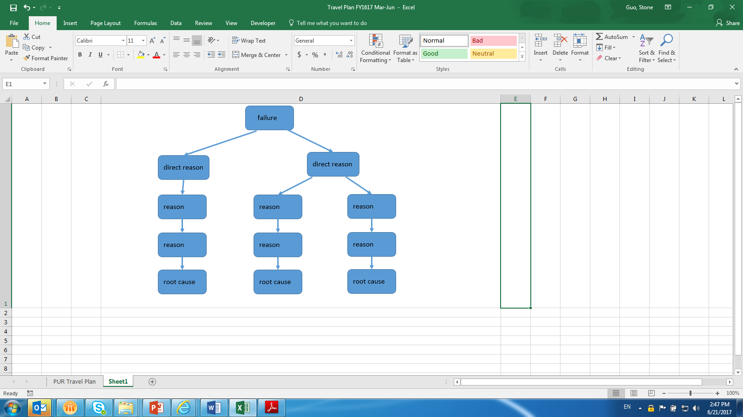
D4 — Root Cause Analysis D4 — 根本原因分析
Study criminal motive
研究‘犯罪’动机
（5 Why/5个为什么)
Appropriate quality tool to investigate all potential root cause, e.g. Fishbone, Failure Tree. It will help us to find all root cause.
运用合适的质量工具调查所有潜在的根本原因，
如：鱼骨图，失效树等。有利于找到根本原因。
Determine real murderer (reproductivity or confirm history record）确定嫌疑人
（再现或确定历史记录）
All root cause shall be analyzed with 5why.
所有的根本原因必须使用‘5个为什么’分析。
The analysis procedure should be clear & reasonable and in system methodology. Recommend to attach detail analysis report in the last page.
分析流程须清晰，合理并具有系统方法。建议将分析附件放在末页。
Identify criminal suspect (Fish bone、FTA、flow chart、,module,FMEA,etc.)
识别嫌疑人（鱼骨图，失效树，流程图，FMEA)
22

Slide 23
D4 — Root Cause Analysis D4 — 根本原因分析
Why did our manufacturing process not prevent the incident?
为什么我们的制造过程没能预防此
事故的发生？
Repeat asking "Why" until you found the root cause (basic incidence), which is feasible to be controlled, e.g. ‘operation WI’, weakness design, supplier management, etc.
不断重复问‘为什么’直到找到根
本原因（基础事故），通常是可行
受控的，如：‘作业指导书’，劣
势设计，供应商管理等
Why did our quality process not detect the incident?
为什么我们的质量过程没有探
测出这个质量事故
Repeat asking "Why" until you found the root cause (basic incidence), which is feasible to be controlled, e.g. ‘inspection WI’, different requirement between xxx with customer or supplier, etc.
不断重复问‘为什么’直到
找到根本原因（基础事故），
通常是可行受控的，如：‘检
验作业指导书’，与客户和供
应商间存在不同的要求
Why did quality planning process not predict this defects?
为什么质量策划流程没有预测到这种不良
For example, no lessons learned, different requirement between xxx with customer or supplier, Poke Yoka, etc
例如：无经验教训，与客户或供应商有不同的要求，防错防呆等
The 5 Whys is a question-asking technique used to explore the cause-and-effect relationships underlying a particular problem. The primary goal of the technique is to determine the root cause of a defect or problem.
‘5个为什么’是一种提问技巧，用来探究特定问题背后的因果关系。它的主要目标是确定缺陷或问题的根源。
23

Slide 24
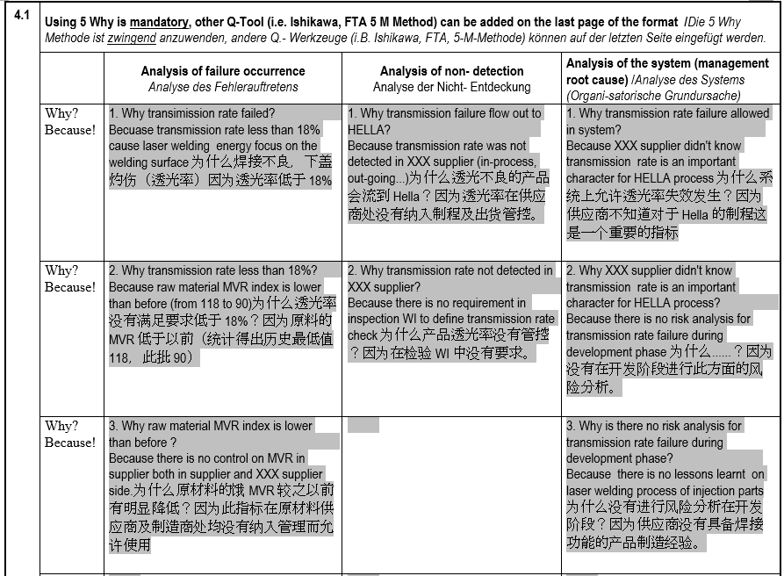
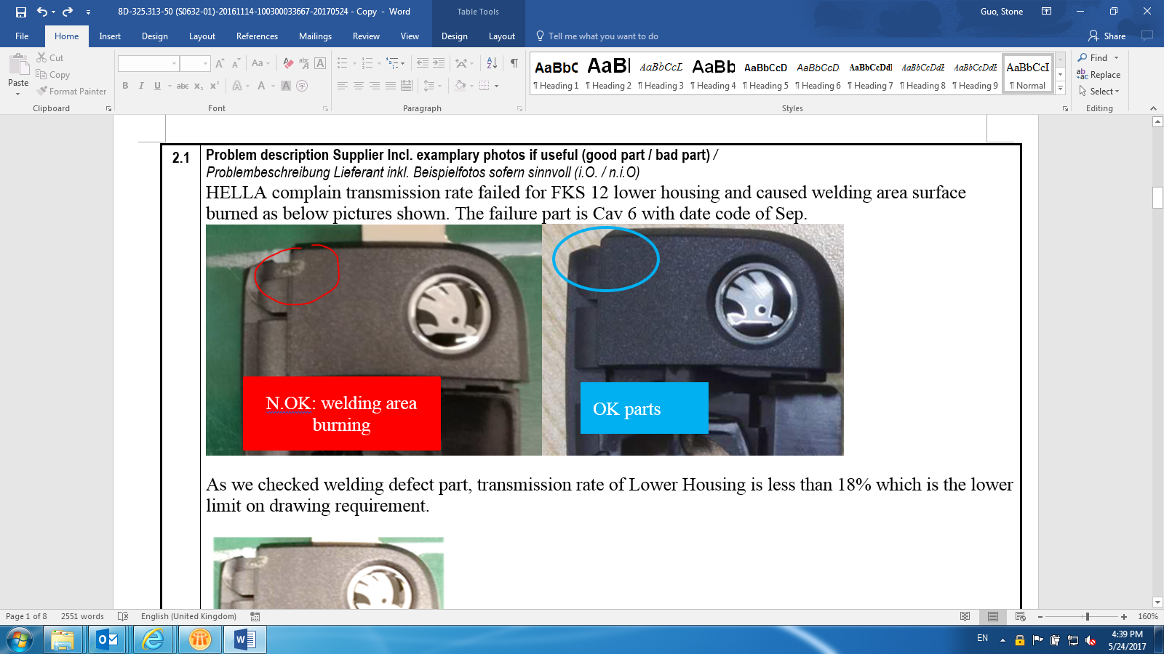
D4 — Root Cause Analysis – example 1
Put a example with possible root causes analysis and verification, and 5 why analysis.
连同可能的原因分析及其验证，并使用“5个为什么”列举案例
Problem description: HELLA complaint Lower Housing can not be welded properly and burnt on the top surface. Defect rate around 6%. Transmission rate of Lower Housing is less than 18% (Spec:min.18%).
Hella 投诉下盖不能很好的焊接并在表面有灼伤。不良率约6%。透光率低于18%。
Occurrence Root Cause: 5M1E checked with fishbone by supplier, only MVR of raw material has variation. DOE was carried out to prove that MVR is a real factor/root cause.
发生的根本原因：使用鱼骨图进行5M1E确认检查，只有原材料的MVR有变异。用DOE证明MVR是真正的根本原因。
24

Slide 25
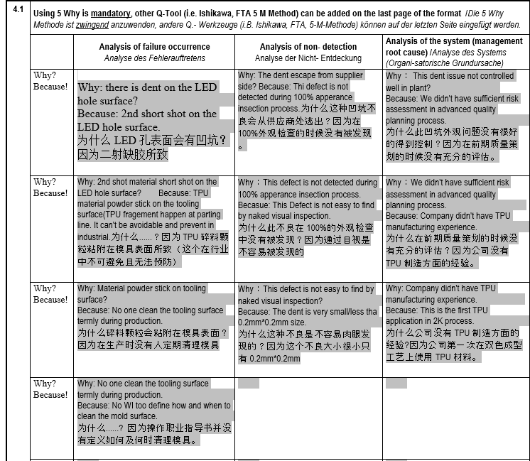
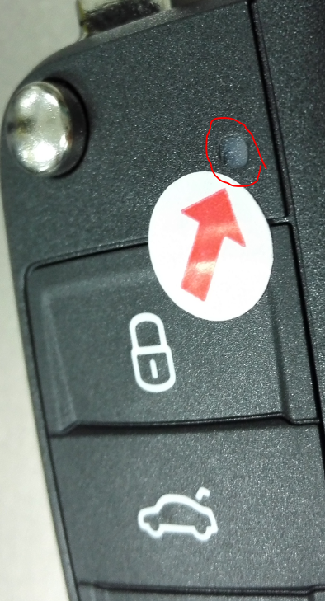
D4 — Root Cause Analysis – example 2
Put a example with possible root causes analysis and verification, and 5 why analysis.
连同可能的原因分析及其验证，并使用“5个为什么”列举案例
Problem description: HELLA complaint there is a dent on the LED hole surface as right picture show.
Defect rate is around 1%. Hella 投诉在LED孔上有凹点如下右图所示。不良率约1%。
Occurrence Root Cause: 5M1E checked with fishbone by supplier, no process change happened. However, no action for tooling surface cleaning (Comment: TPU fragment happen at parting line and it’s unavoidable.)
发生的根本原因： 使用鱼骨图对5M1E进行确认检查，过程没有发生变化。然而，没有对模具表面进行清理(备注：TPU碎屑发生在分型线，这是不可避免的）
25

Slide 26
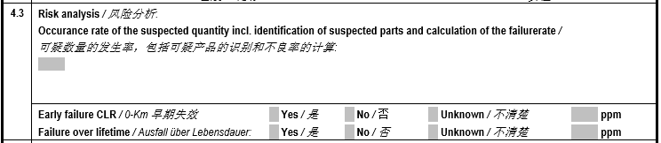
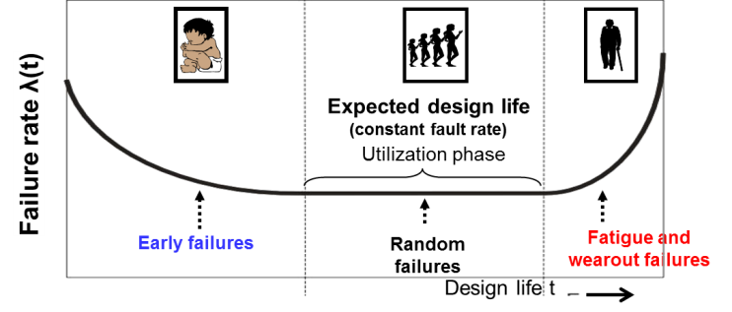
D4 — Root Cause Analysis D4 — 根本原因分析
1
2
3
1
Total sorting quantity, and total defects parts quantity and calculate PPM value.
用总分拣数量和总不良品数量计算PPM值
Show mark/labeling to highlight the suspect parts.
对于可疑品需要特殊标识
Total defect parts of lifetime
截至目前总不良品数量
*10
Total produced parts of lifetime
截至目前总生产数量
6
2
The problem is easy to find and identify, short period failure. If yes, please calculate PPM and fill in. 如果是容易发现和识别的短期失效，请计算PPM。
3
The problem is difficult to find or never found but was existing, long period failure. Even from the SOP to now. If yes, please calculate PPM and fill in. 此类问题发现相对比较困难或之前一直没有发现，但是是存在的，甚至从SOP到现在长期失效。如果是此类，请计算PPM。
26

Slide 27
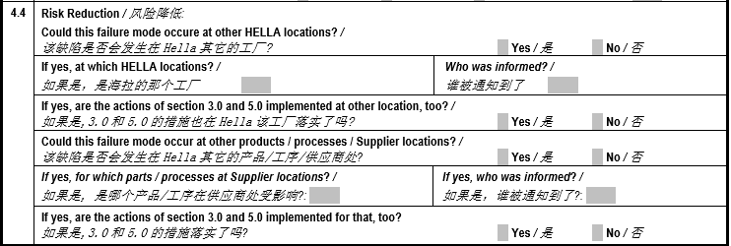
D4 — Root Cause Analysis D4 — 根本原因分析
The easiest lesson learned is spreading the experience to other similar products and processes.
最简单的经验教训是将经验传播到其他类似的产品和过程中。
Read across is a good approach to gain lessons learned. Don’t neglect this process.
水平展开是获得经验教训比较好的方法。不要忽视它。
27

Slide 28
D5 – Corrective Actions and Tracking of Effectiveness tra D5 – 纠正措施及效果跟踪cking of effectiveness
D1
D2
D3
D4
D5
D 6
D 7
D 8
Task
任务
Confirm "optimum" corrective actions
确定最佳纠正措施
All measures that can solve and ultimately eliminate the problem must be compiled.
所有的措施能解决并最终消除问题。
The effectiveness of the measures must be verified and side-effects must be assessed.
措施的有效性必须得到验证并且副作用也得评估
“Optimum" corrective action must be determined and confirmed.
最佳纠正措施必须确定下来并得到确认。
Action plan with introduction timing and responsibilities must be determined and released.
带有时间节点的行动计划和责任人必须确定并发布出来。
Approval and application of the corrective measures
纠正措施得到批准及应用
Action
行动
Target
目标
28

Slide 29
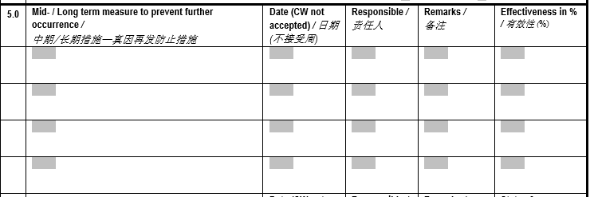
D5 – Corrective Actions and Tracking of Effectiveness D5 – 纠正措施及效果跟踪tracking of effectiveness
1
2
3
4
5
1
Corrective actions must be provided and all of them could prevent the issue from happening in the future.纠正措施必须提供且能预防此问题的再次发生
Long term measures should
link to D4 root causes
长期措施应与D4衔接
2. 20 working days: effectiveness
for permanent corrective action checked and recurrence prevented
20个工作日完成永久对策有效性验证
2
Supplier action date instead of week.
供应商行动日期而不是周
3
Person who is responsible for containment action.
遏制行动的负责人
4
Additional comments. 备注
5
Supplier must confirm if countermeasure is carried out
and effective.供应商必须确认措施是否执行且有效
29

Slide 30
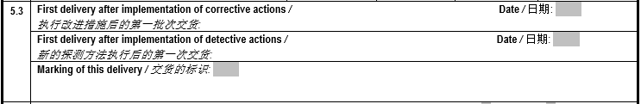
D5 – Corrective Actions and Tracking of Effectiveness D5 – 纠正措施及效果跟踪tracking of effectiveness
1
2
3
1
Please fill in the date after corrective action taken for occurrence.
请填写执行改进措施后的第一批交货的日期。
2
Please fill in the date after corrective action taken for detect.
请填写新的探测方法执行后的第一次交货的日期。
3
Please also attach the picture of the marking of the first delivery.
请附上交货的标识或图片
30

Slide 31
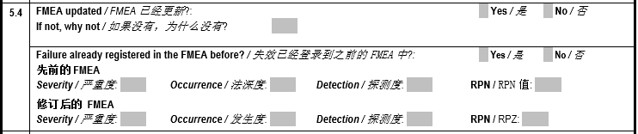
D5 – Corrective Actions and Tracking of Effectiveness tr D5 – 纠正措施及效果跟踪acking of effectiveness
“Why was the failure not detected by yourself” links to “Detection” in FMEA
“Why did the failure happened” link to “Occurrence” in FMEA. Attach updated FMEA here.
‘为什么失效自己没有探测出来’与FMEA中的探测度衔接。
‘为什么失效发生’与FMEA中的发生度衔接。 此处附上FMEA。
Severity only allowed to change when the design of component changes according to complaint.
严重度 只允许在零件设计变更时改变
Occurrence only allowed to change when 5.0 take relevant actions to 4.0.
发生度 只有当4.0中的质量特征在5.0中采取相应的措施后才允许改变
Detection only allowed to change when 5.1 take relevant actions to 4.1.
探测度 只有当4.1中的探测方法在5.0中采取相应的探测手段提高后才允许改变
31

Slide 32
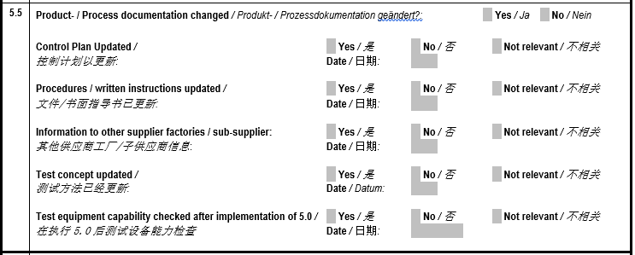
D5 – Corrective Actions and Tracking of Effectiveness t D5 – 纠正措施及效果跟踪racking of effectiveness
1
2
1
Ensure all relevant documentations are updated on time.
确保所有相关的文件都得到及时更新。
2
If the long term counter-measure in 5.1 related to test method or equipment changed, capability study must be re-checked.
如果5.1中的长期措施涉及到测试方法或设备变更了，检验能力必须重新确认。
32

Slide 33
D6 – Corrective Actions Effectiveness Validation of eff D6 – 纠正措施效果验证ctiveness
D 1
D 2
D 3
D 4
D 5
D6
D 7
D 8
Task
任务
Establish plan to introduce corrective actions
确定纠正措施计划
As many actions as required, but as few as possible, should be implemented in accordance with D5 result.
应根据D5的结果执行并完成必要的纠正措施。
Decision about the need to continue containment actions.
决定继续遏制措施的必要性。
Determination of process monitoring requirements and need of documentation.
确定过程监控要求及文件需要。
Implementation of the corrective actions
纠正措施执行
Action
行动
Target
目标
33

Slide 34
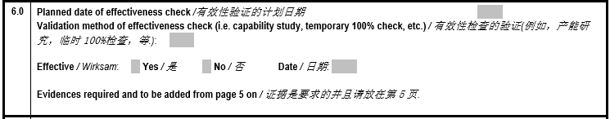
D6 – Corrective Actions Effectiveness Validation of ef D6 – 纠正措施效果验证fectiveness
1
2
3
1
Verify all effectiveness for both occurrence root cause and outflow root cause and fill in related date.
验证发生源和流出源的纠正措施的有效性并填写验证日期。
2
How to check the effectiveness should be specified. At least should be more strict than normal check method.
如何检查有效性应该被详细说明。至少应该比正常方法严格。
3
Attach ‘Hella full run report’ or SPC report, or other verification report.
附上‘Hella 全速运行报告’或SPC,或其他验证报告。
Without this verification, this 8D report will not be closed by Hella. Please attach all evidence in the last page of format.
如果没有验证，这个8D是无法关闭的。请在最后一页附上所有的证明资料。
34

Slide 35
D7 – Prevention of Recurrence of the non-Conformity D7 – 异常再发生的预防
D 1
D 2
D 3
D 4
D 5
D 6
D 7
D 8
Formulate measures to improve and safeguard processes
制定改善和保障流程的措施
Process-related evaluation and analysis is key.
过程相关的评估和分析是关键
Identical and similar products and processes are in focus.
相同和类似的产品及过程是需要高度重视的
Application of the "3 x 5 Why" questioning technique:
“3 x 5为什么”质疑技术的应用： Why was the problem ...为什么问题… ... not predicted by the product planning/engineering process?
... 没有在先前产品质量策划/工程过程预见到？ ... not prevented by the production/manufacturing process?
… 没有在生产/制造过程中预防成功？ ... not protected by the quality assurance process?
… 没有受到质量过程的保护？
Knowledge gained is used to improve processes.
所获得的知识用于改善过程
Task
任务
Action
行动
Target
目标
Release and application of corrective actions for system and process improvement
对系统和过程改进措施的批准和应用
35

Slide 36

D7 — Prevention of Recurrence of the non-Conformity D7 – 异常再发生的预防
1
Whatever for final judgement, supplier must finish D4.不管最终判定结果如何，供应商都必须完成D4
2
3
4
1
Fill in date of supplier final judgement for below information.
供应商根据以下最终判定结果填写
2
If it is a supplier responsible issue, supplier need to select ‘claim is accepted’.
如果是供应商的责任，请选择‘抱怨接受’
3
If this issue is supplier responsible, please provide all failure part quantity after sorting/rework for Hella stock.
如果是供应商的责任，请提供对Hella库存分拣/重工后的失效件的数量
4
If this issue is not supplier responsible and get Hella agreement, supplier can select “claim is not accepted’.
如果这不是供应商的责任，在得到Hella同意后可以勾选‘抱怨不接受’
36

Slide 37
D8 – Final meeting D8 – 末次会议
D 1
D 2
D 3
D 4
D 5
D 6
D 7
D8
Task
Final meeting of the 8-D team 8D团队的末次会议
During the concluding discussion, the problem solving team conducts a critical evaluation of all 8-D steps and actions.
在总结讨论时，问题解决小组对所有8D步骤和行动展开严格的评估。
The 8-D report is officially closed. 8D 报告被正式关闭。
Combined efforts by the team are acknowledged by supervisors and praised accordingly.
团队的共同努力得到了主管的认可，并得到了相应的表扬。
The customer is informed of the conclusion and sent the 8-D report, signed by those responsible.
客户被告知结论，并将责任人签署的8-D报告发送给客户。
The completed 8-D report is archived. 完成的8-D报告存档。
Final conclusion of 8-D activities related to this problem
与此问题相关的8-D活动的最终结论
Action
Target
37

Slide 38
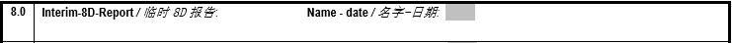
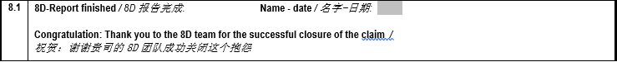
D8 — Final meeting D8 – 末次会议
Please fill in interim 8D report submission date and responsible person’s name.
请填写临时8D报告提交日期和负责人姓名。
Please fill in Final 8D report submission date and responsible person’s name.
请填写最终8D报告提交日期和负责人姓名。
38

Slide 39
Motivation to make the 8D report
编写8D报告的动机
How to fill out Hella 8D report
如何填写海拉8D报告
8D Report Evaluation
8D报告的评估
8D Training suppliers | Keppmann | HCC-PU-QME - Lippstadt, Nov 2017

Slide 40
8D Report Evaluation 8D报告评估 Why need to do evaluation? 为什么需要评估？
Use the same criteria to assess 8D report objectively, to reflect the capability of suppliers
使用相同的标准客观地评估8D报告，以反应供应商的能力。
Be able to clearly recognize which part of the report does not meet the requirements and make corrections accordingly.
能够清楚地认识到报告的哪一部分不满足要求，并随之作出相应的纠正。
Suppliers can assess by themselves if 8D report meet the requirements before submit to Hella, which can improve the effectiveness of the work.
供应商在提交给Hella前可以自行评估8D报告是否符合要求，这可以提高工
作的有效性
According to the evaluation results, the interior of Hella can define the tracking plan for each case.
根据评估结果，Hella内部可以为每个案件定义跟踪计划。
Evaluation result is one of the evidence for annual performance scoring.
评估结果是年度绩效考核的依据之一。
40
Notes:
29.05.2018

Slide 41
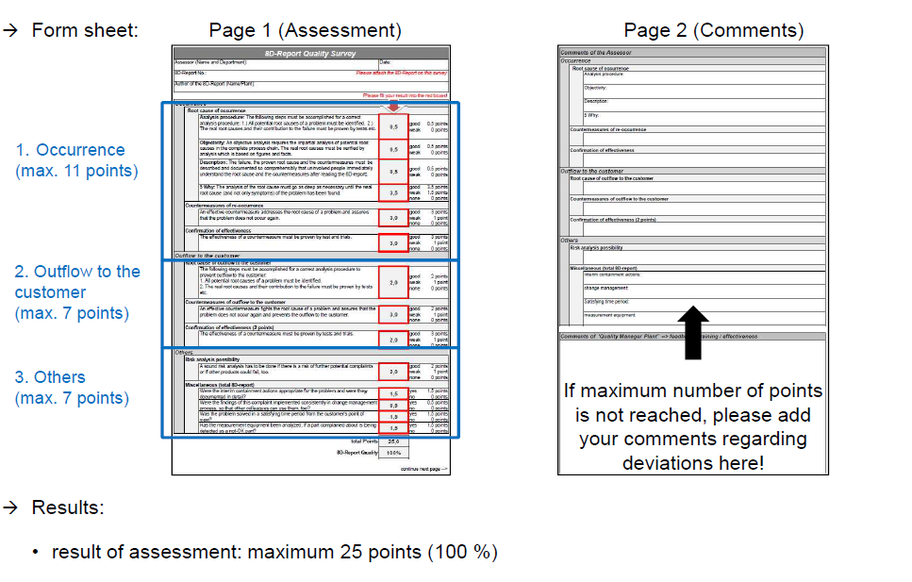
8D Report Evaluation 8D报告评估 How to fill out 8D quality survey? 如何填写8D质量调查？
第一页（评价）
第二页（备注）
格式
发生频次
（最多11个点）
流出到客户端
（最多7个点）
其他
（最多7个点）
结果：
如果没有达到最大评价点，请在这里填写备注！
评价结果：最多25 个点（100%）
8D Training suppliers | Keppmann | HCC-PU-QME - Lippstadt, Nov 2017

Slide 42
8D Report Evaluation 8D报告评估 Scorings 得分
Please take note that HELLA is internally doing an 8DR assessment, you should take influence to the score
by considering the below listed questions before providing the final 8DR.
请注意，HELLA正在内部进行8D报告评估，在提供最终的8D报告之前，您应该考虑以下列出的问题对评分的影响。
42

