Slide 1

HELLA Lithuania – HLT
2026

Slide 2
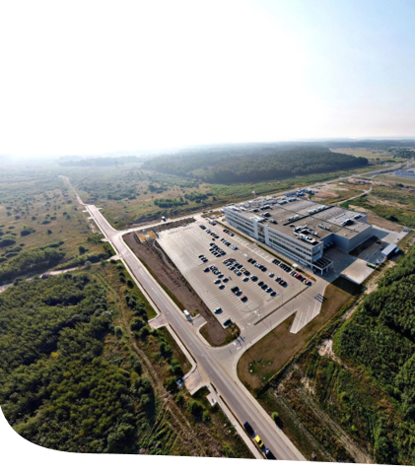
Key Facts
HELLA Lithuania – a central pillar of the HELLA Electronics business growth strategy in Europe
HELLA Lithuania is a pure production site
We have all functions on site which are necessary to run our operations smoothly
We are industrializing new production projects and running series production​.
Our responsibility ranges from taking care of purchased parts and manufacturing equipment until delivery of the final product to the customer​.
We support HELLA’s global sales team to acquire projects and the global development teams in the design of our products​.
Production, Launch Management, Logistics, Technical Service and Quality departments are preparing and running the business​.
Purchasing, Finance & Controlling, Human Resources and Administration are supporting them.
Product portfolio consists only of automotive electronics parts

Slide 3

Decision Rationale
Overall strategic rationale for a new plant in Europe – running out of space in the mid-term
High availability of qualified workforce
Highly developed country
Part of the EU, EURO zone and NATO​.
Very good road / sea infrastructure.
Good manufacturing availability and high electronics motivation.
High availability of education e.g. Kaunas University of Technology.
High English level​.
Low attrition rates.
Lithuania was chosen out of originally 17 countries – decision after evaluation of empirical data, on-site visits, interviews with international companies located in Lithuania and consultation of HELLA customers

Slide 4

Location
Plant located in Kaunas Free Economic Zone (FEZ)​
8.8 km to Kaunas city center and 7.3 km to Kaunas airport
|
P.4
HELLA Lithuania – HLT – August 2026

Slide 5
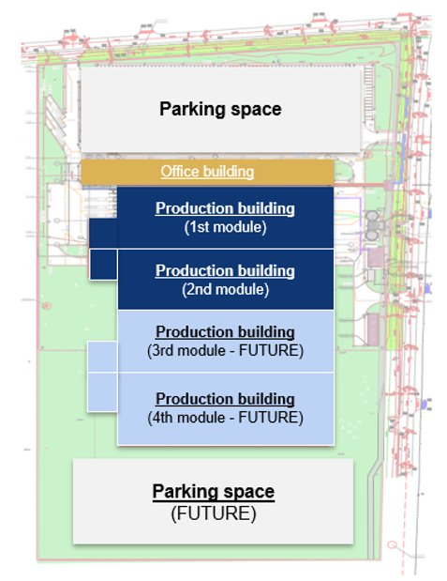
Land Plot
Kaunas Free Economic Zone selected due to favorable location, pre- installed infrastructure & expansion possibility
Total size of land plot: 89,297m²
  Utilization in four construction steps​
  Extension started 2nd production module & engineering center
  Plant today:
    7,592 m² shopfloor​
    5,670 m² warehouse​
    3,300 m² office
|
P.5

Slide 6
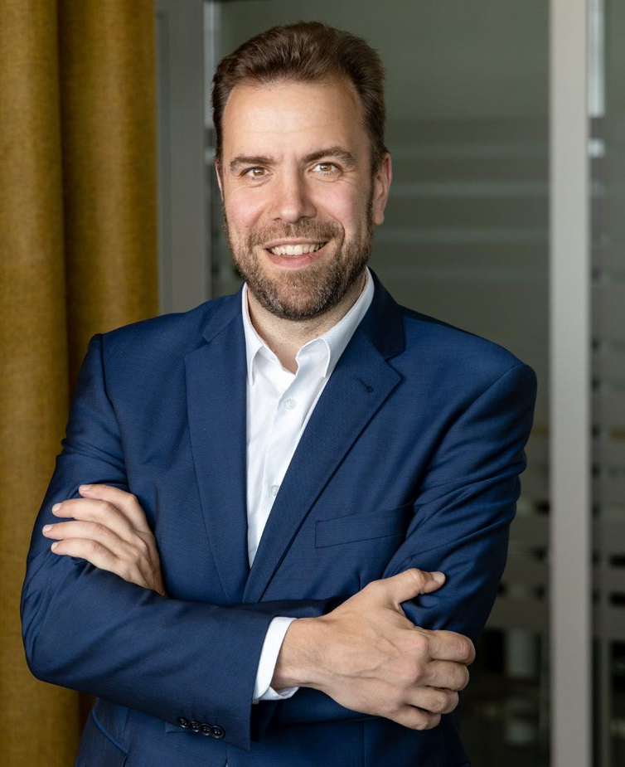
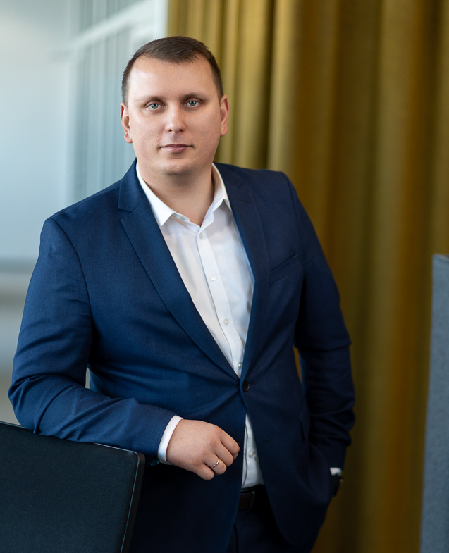
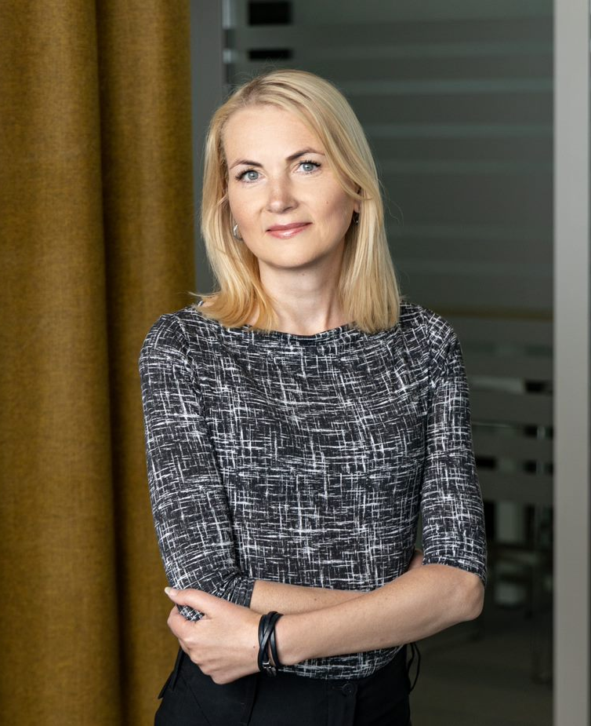
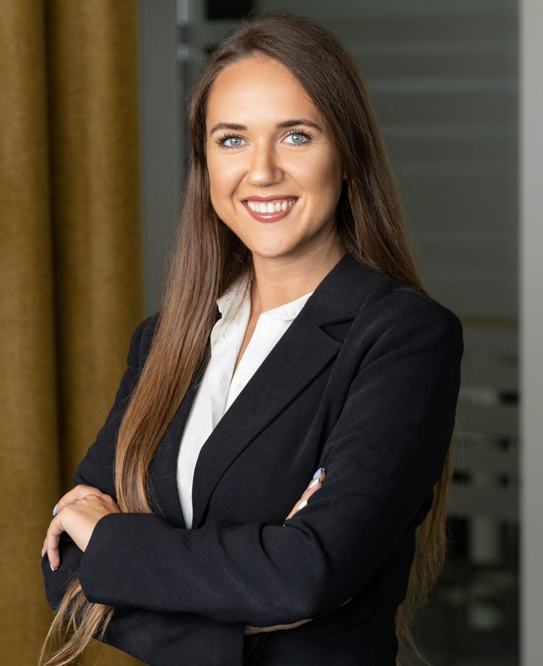
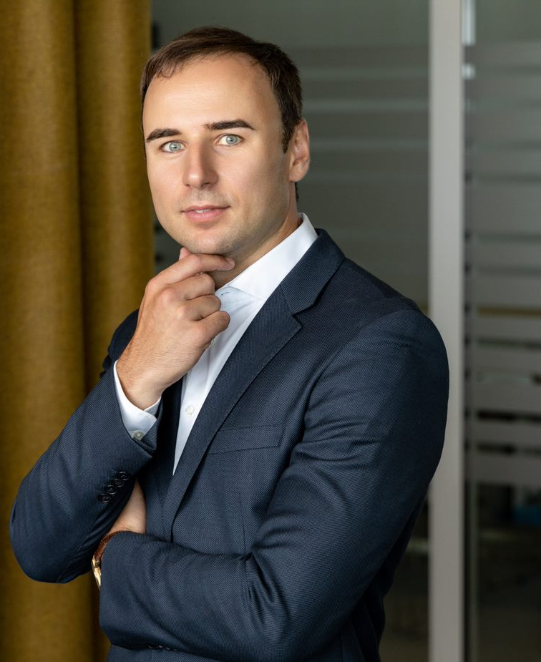
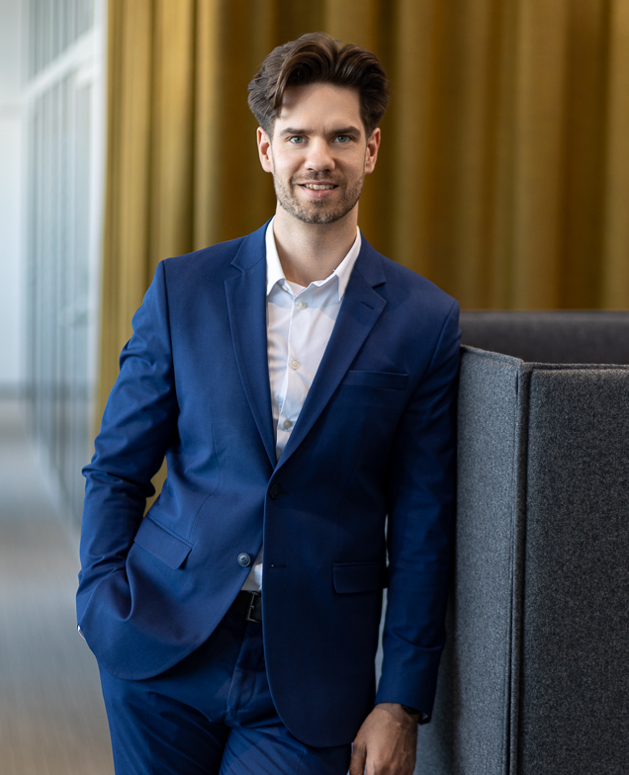
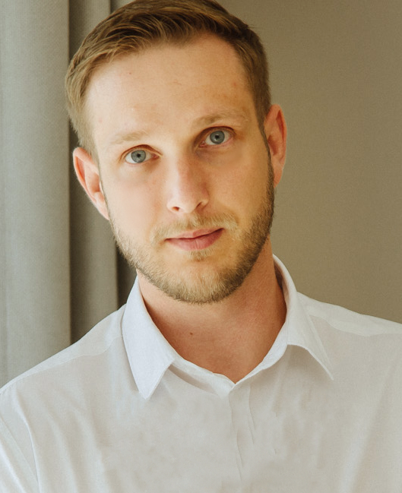
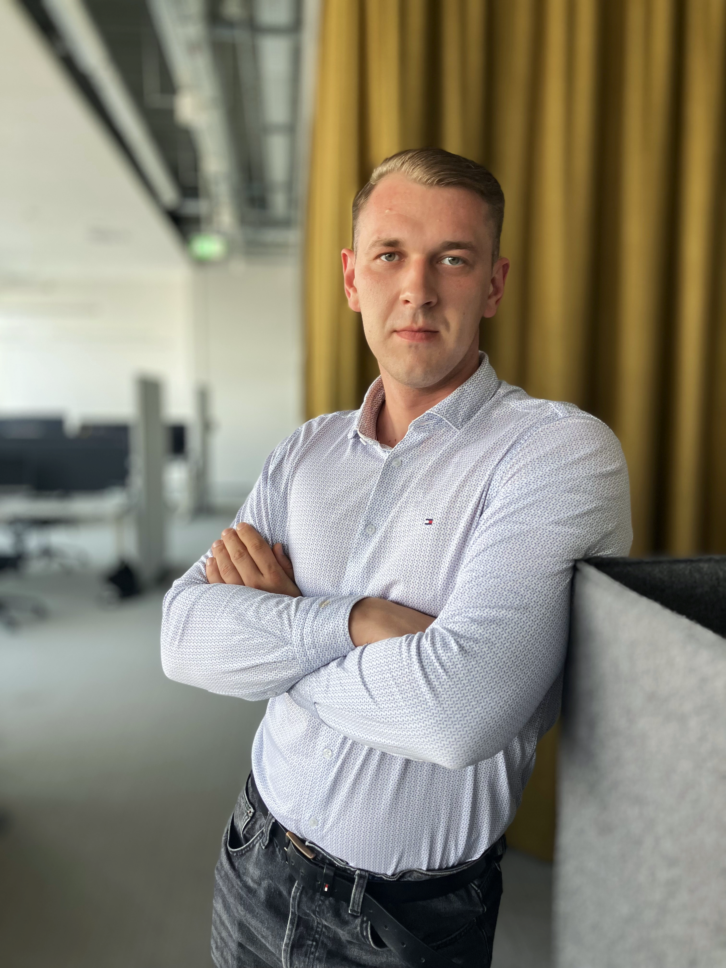
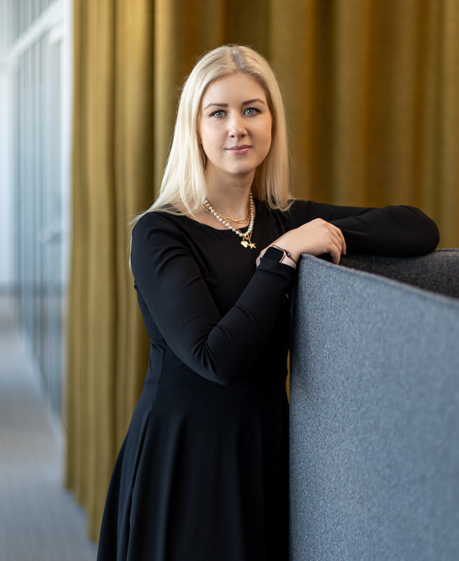
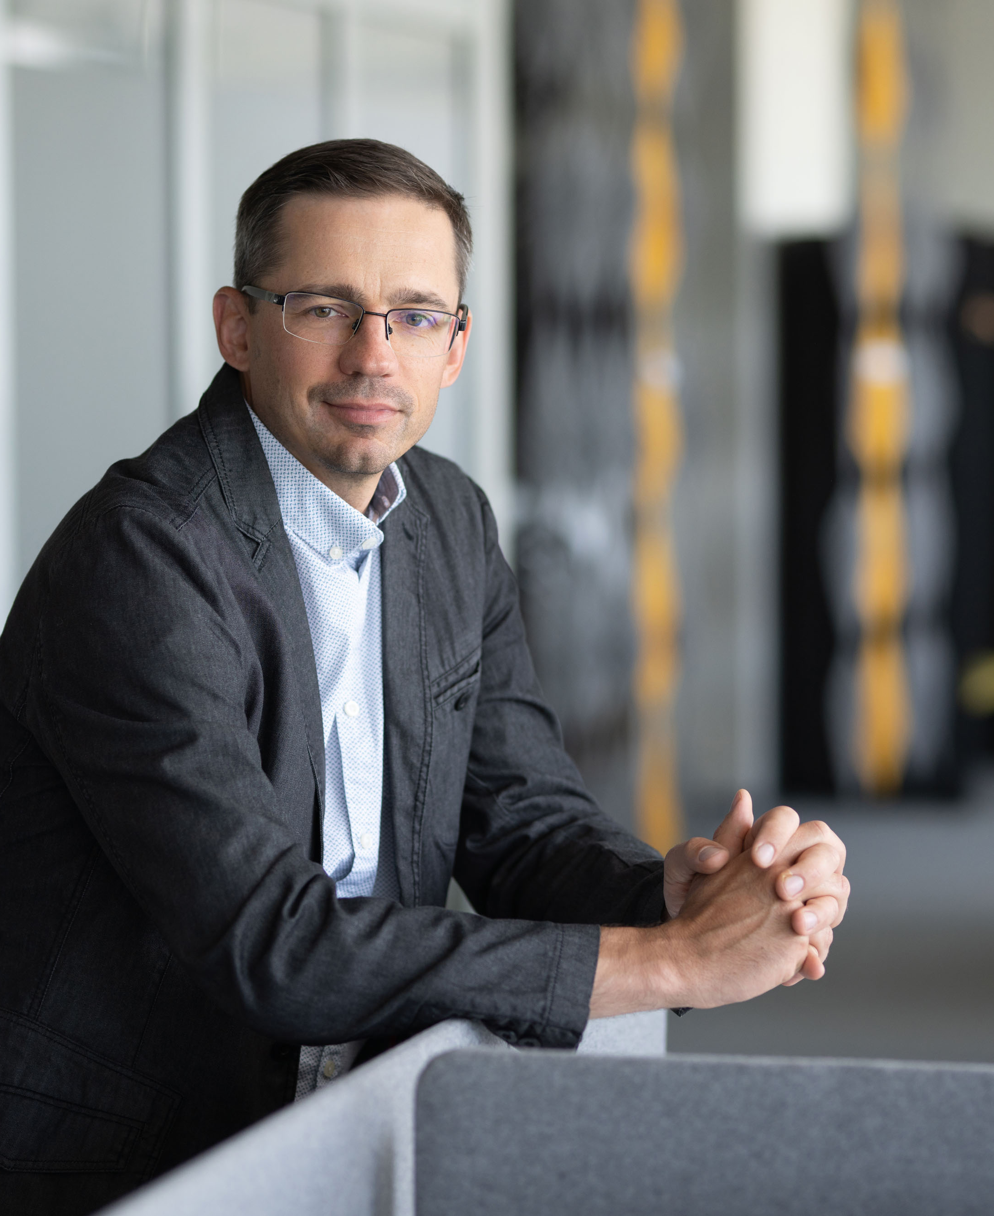
Leadership Team
Managing Director / Purchasing Indirect
Maxim Zakletskiy
Human Resources
Jurgita Macijauskienė
EHS &Regulatory Services
Justas Jurgaitis
Head of Quality
Donatas Vlasovas
Head of Operations and temporary IF2
Mantas Skinderis
Finance & Controlling / Operations Services
Liveta Cirtautaitė
Internal Factory 1
Tomas Ziutelis
Logistics
Živilė Dabašinskienė
Technical Service
Arvydas Maciulevičius
Temporary Internal Factory 3
Artūras Gulbinas
|
P.6
HELLA Lithuania – HLT – August 2026

Slide 7
Team Structure
Employee Gender Distribution
Employee Age Distribution
Employee Location Distribution
Men
>40 y. o.
Foreign countries
26-40 y. o.
Kaunas
Other cities
21%
15%
Women
<25 y. o.
Kaunas district
Actual HC
Planned HC
472 employees
All employees are trained
employed by 03.08.2026
based on the requirements of their positions in existing HELLA plants and central departments
34 years
the average age
|
P.7
HELLA Lithuania – HLT – August 2026

Slide 8

HLT DNA
Being the team of openminded intrapreneurs in automotive electronics
Growing together
Acting as one team leading by example with integrity. Keeping focus on continuous development of each other.
Working as intrapreneurs
Being result oriented, driving efficiency and proactively handling our commitments.
Being open minded
Considering feedback as a gift and constructively sharing our knowledge

Slide 9
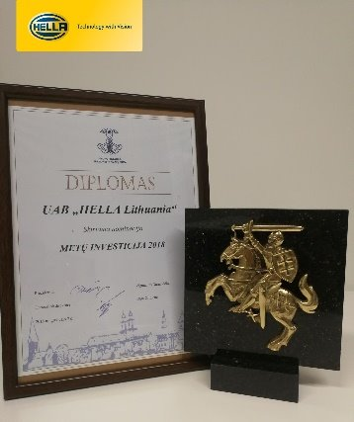
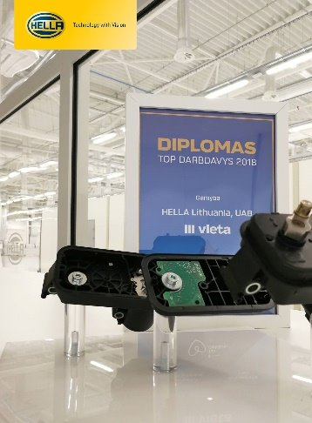

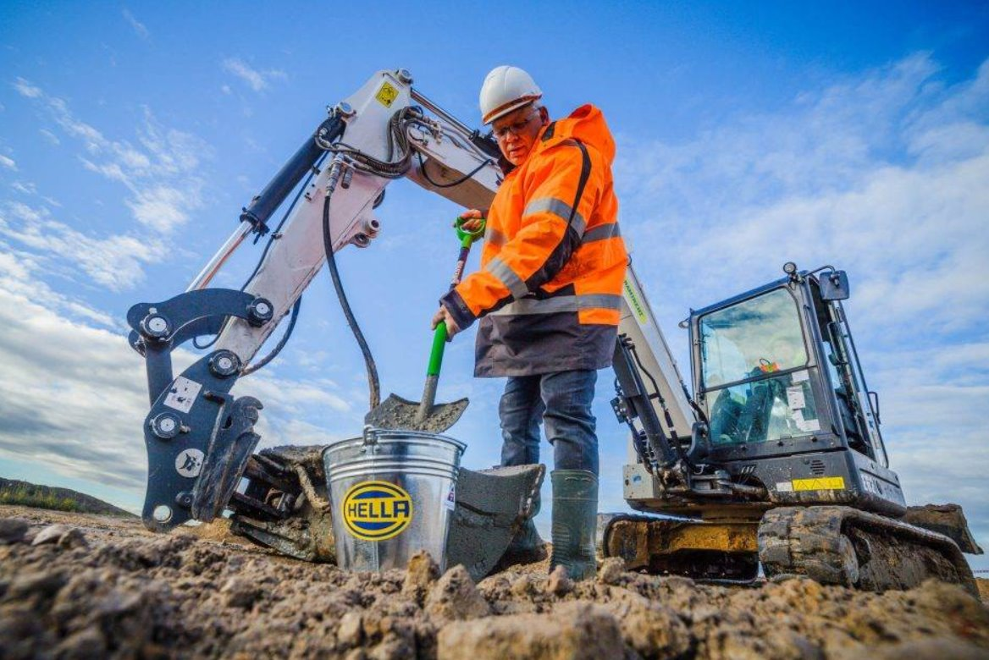
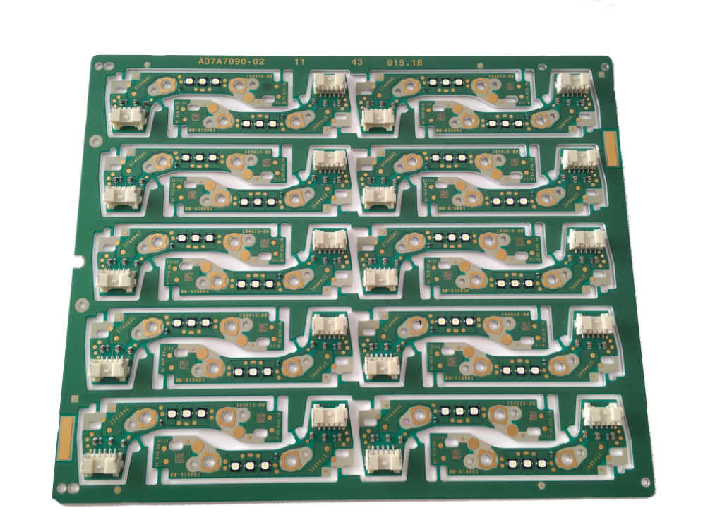
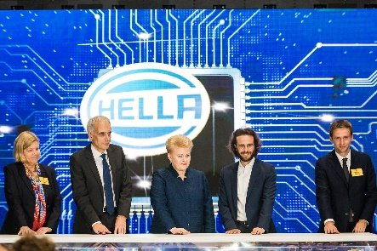
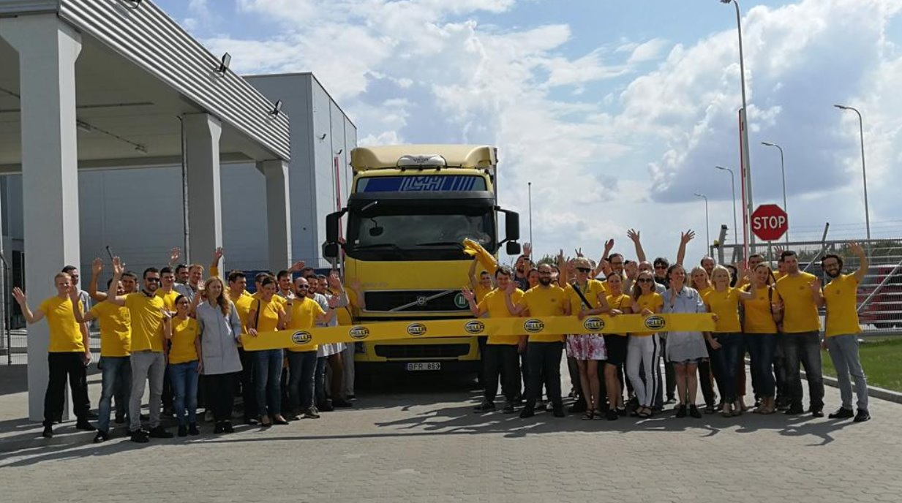
Company highlights and roadmap
Award: Investment of
the 2018 in Lithuania
IATF letter of conformity received
IATF 16949 and ISO 9001 certification audits passed
MLS Matrix Kit front LED lighting (iBtP project)
Legal registration of UAB HELLA Lithuania
Start of operations
Award: 3rd best employer in Lithuania in manufacturing
MLS BiLED 2.0
front LED lighting (iBtP project)
Matrix Kit
interior LED lighting (iBtP project)
Oct, 2017
Jul, 2018
Sep, 2018
Jan, 2019
Jun, 2019
Oct, 2019
Mar, 2020
Jul, 2020
Jun, 2017
Jun, 2018
Aug, 2018
Dec, 2018
Feb, 2019
Sep, 2019
Apr, 2020
SOP of 3rd iBtP project
Waste Gate Actuator for turbocharged gasoline engines
MRA2
PCBAs for the interior lighting (iBtP project)
Groundbreaking /
Start of construction
Official opening
ceremony
SOP of 4th iBtP project
24GHz Radar Sensor
for rear applications
4 Mio € sales
generated in FY18/19
First shipment to the customer
|
HELLA Lithuania – HLT – August 2026
P.9

Slide 10
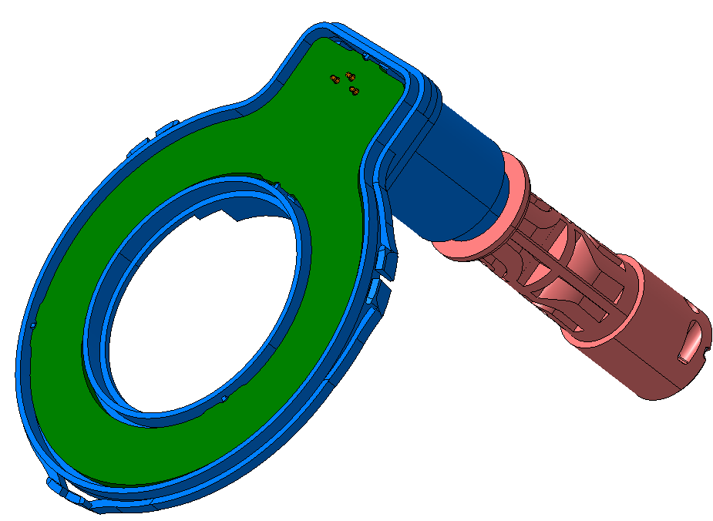
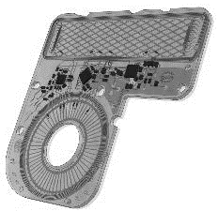
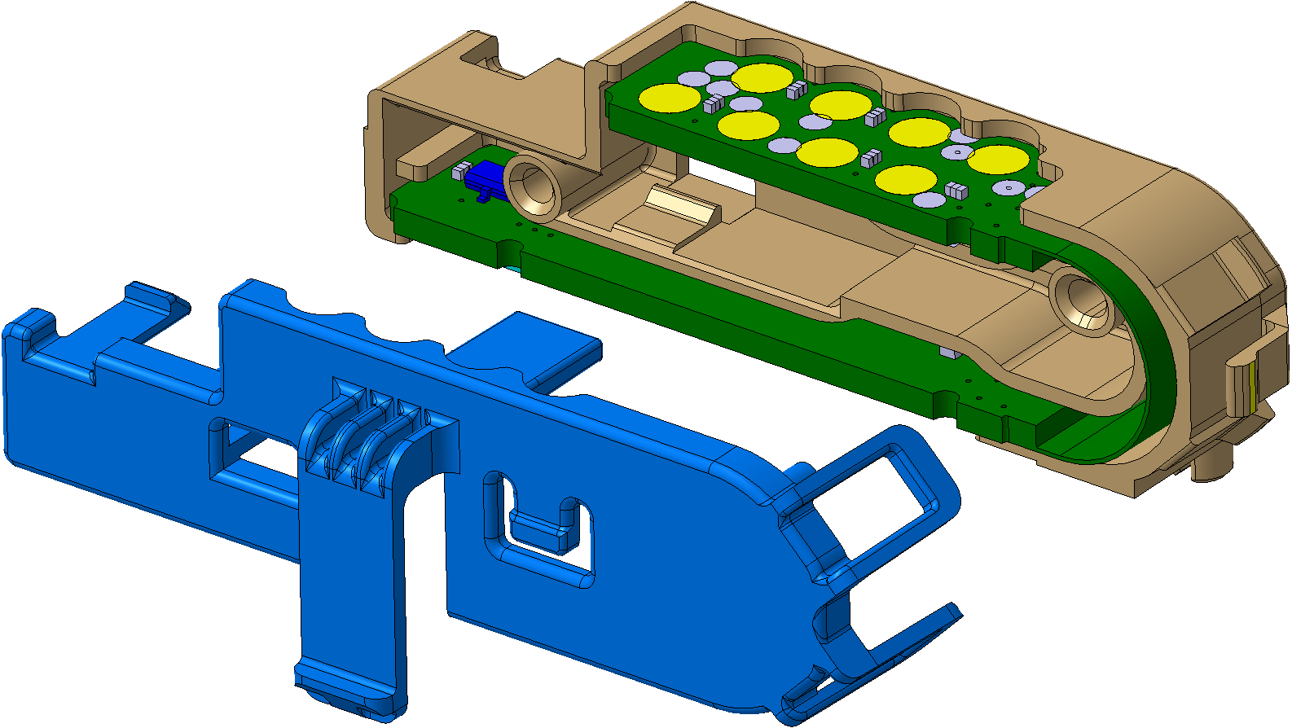
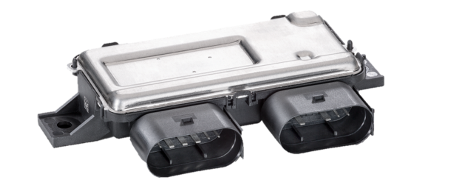
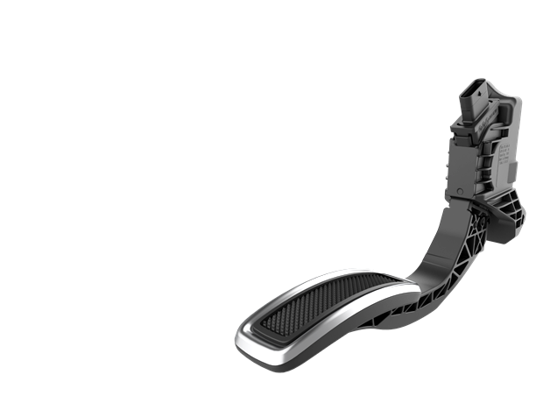

Company highlights and roadmap
Vehicle Level Sensor
for active suspension control
Inductive Motor Position Sensor + IBC
Used in electro hydraulic braking systems
Fuel Control Module II
for more efficient fuel consumption
Electronic Valve Actuator PCBA
front LED lighting (iBtP project)
BiLED 4.0
front LED lighting (iBtP project)
Electric Braking
Booster Sensor
for more efficient braking
Fuel Control Module I
for more efficient fuel consumption
Apr, 2021
Mar, 2022
Apr, 2022
Jan, 2023
Sep, 2023
Jun, 2025
Mar, 2027
Jan, 2021
Sep, 2021
Oct, 2021
Jul, 2022
Apr, 2024
Feb, 2026
Internal Factory 3 opening
Compact Valve Block
for seating comfort (external BtP project)
Accelerator Pedal Sensor front LED lighting (iBtP project)
Internal Factory 2 opening
Motor Position Sensor
for electronically commutated motors
Universal Turbo Actuator 3 PCBA
for turbocharged diesel &
gasoline engines
77GHz Radar Sensor
for dynamic objects & environment modelling
|
P.10
HELLA Lithuania – HLT – August 2026

Slide 11
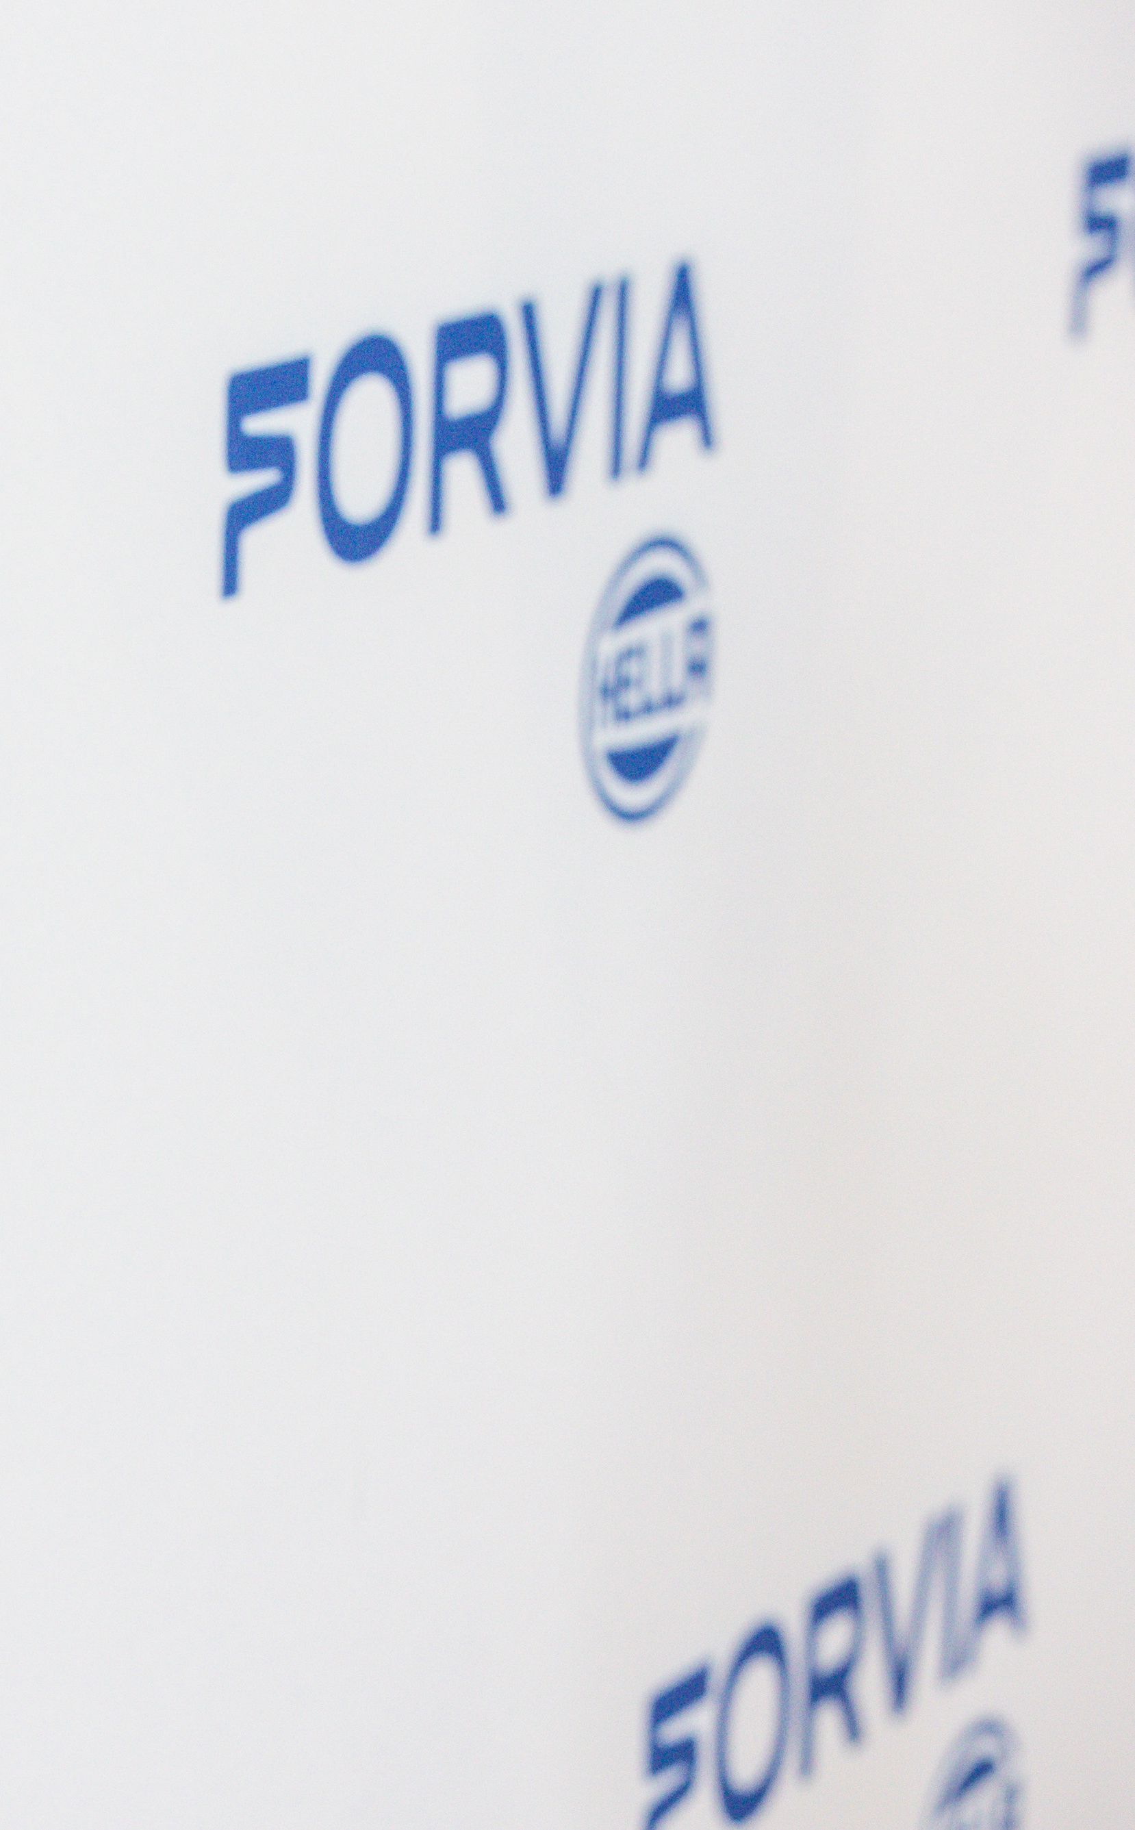
EXPERIENCE
An active management of know how and Lessons Learned allows a consistently high quality in the HELLA network
Focus on implementation of low risk projects
First project launches with focus on proven process technologies and products (Lighting assembly groups, Fuel Control Module (FCM) Waste Gate Actuator (WGA), Radar Sensor)
Standardized plant layout, business processes and SAP
Plant layout is unified regarding material flow and planning of different areas based on experience from existing plants
Key operations and logistics processes are defined with headquarters according to corporate processes
Setup of SAP system was derived from these results
Strong engagement of lead plants, technology networks and central functions
Lead plant concept involves experienced HELLA engineers to ensure a high quality level worldwide
Technology networks include project support, monthly conference calls and yearly Face2Face meetings to address challenges with core technologies

